Slide 1

Face Recognition Attendance System
CSA17 Artificial Intelligence
Course Faculty : Dr. Krishna Kumar Kathiresan, Professor, SIMATS Engineering, SIMATS
PRESENTED BY:
B.Bhargavi-1923211136
Komboji Thanuja-192373012

Slide 2

ABSTRACT
• AI-Based Face Recognition Attendance System is a smart and automated system designed to record and manage student attendance using Artificial Intelligence and face recognition technology.
• The system captures student faces using a webcam/camera and identifies registered students automatically.
• The system uses AI-based facial feature extraction and matching to recognize students and mark their attendance.
• The attendance details such as student name, ID, date, time, and attendance status are stored in a centralized database.
• The system helps to reduce manual work, save time, improve attendance accuracy, and prevent proxy attendance.
• The system also provides attendance reports and performance monitoring for teachers and administrators.
CSA1711-01

Slide 3


INTRODUCTION
• AI-Based Face Recognition Attendance System is an automated system developed to simplify the process of recording student attendance.
• Traditional attendance methods such as manual registers and roll calls require more time and may lead to errors.
• This system uses Artificial Intelligence, Computer Vision, and Face Recognition to identify students through a camera.
• Each student’s face is first registered and stored in the system for future identification.
• During attendance, the camera captures the student’s face and compares it with the registered facial data.
• When a student is recognized, the system automatically records the student ID, name, date, and time.
• The attendance data is stored in a database, making it easy for teachers to view and manage records.
CSA1711-02

Slide 4
PROBLEM STATEMENT
• Traditional attendance systems require manual work, which is time-consuming for teachers.
• Manual attendance can lead to human errors, such as incorrect marking or missing records.
• Proxy attendance may occur when one student marks attendance for another student.
• Maintaining attendance records manually becomes difficult when the number of students is large.
• It is difficult to quickly search, update, and generate attendance reports using paper-based methods.
• Therefore, an AI-based Face Recognition Attendance System is proposed to automatically recognize students and record their attendance accurately and efficiently.
CSA1711-04

Slide 5
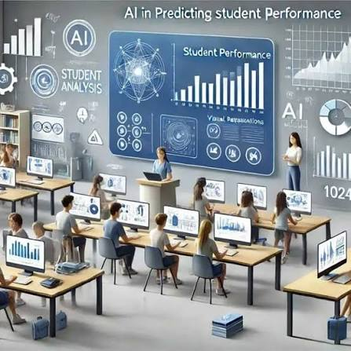
OBJECTIVES
• To develop an AI-based system for automatic student attendance management.
• To identify and recognize students using facial recognition technology.
• To automatically mark attendance when a registered student is recognized.
• To reduce manual work, time, and human errors in attendance recording.
• To help prevent proxy attendance by verifying the student’s face.
• To securely store attendance records with student details, date, and time.
• To provide easy access to attendance reports for teachers and administrators.
• To improve the accuracy, efficiency, and reliability of the attendance process.
CSA1711-05

Slide 6
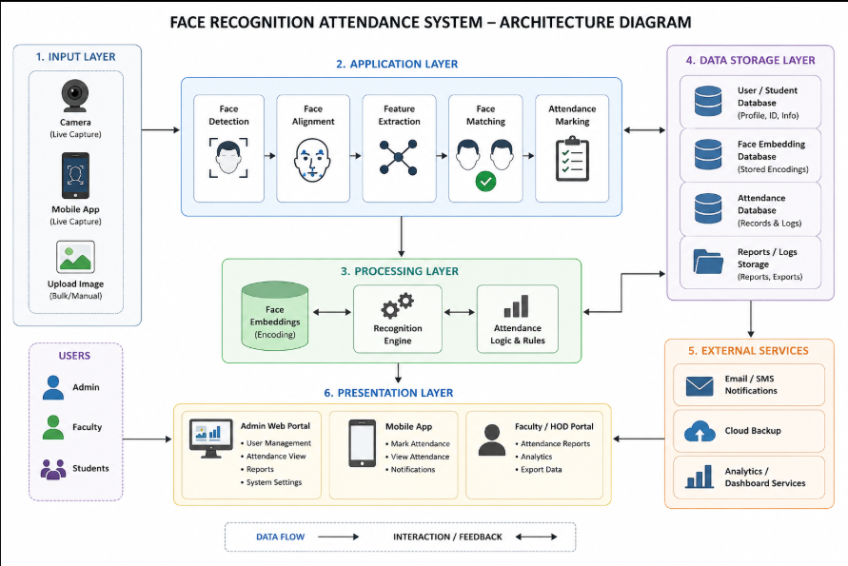
SYSTEM ARCHITECTURE
CSA1711-06

Slide 7
Module 1: Student Registration & Face Recognition
The module is responsible for registering student information in the system.
The admin can enter details such as Student ID, Name, Department, Year, and Section.
The system uses a webcam to capture multiple images of each student.
The captured images are processed using image processing techniques to improve recognition accuracy.
The system detects the student’s face from the captured image.
Facial features are extracted using AI-based face recognition techniques.
The extracted facial features are converted into face embeddings and stored securely.
CSA1711-07

Slide 8
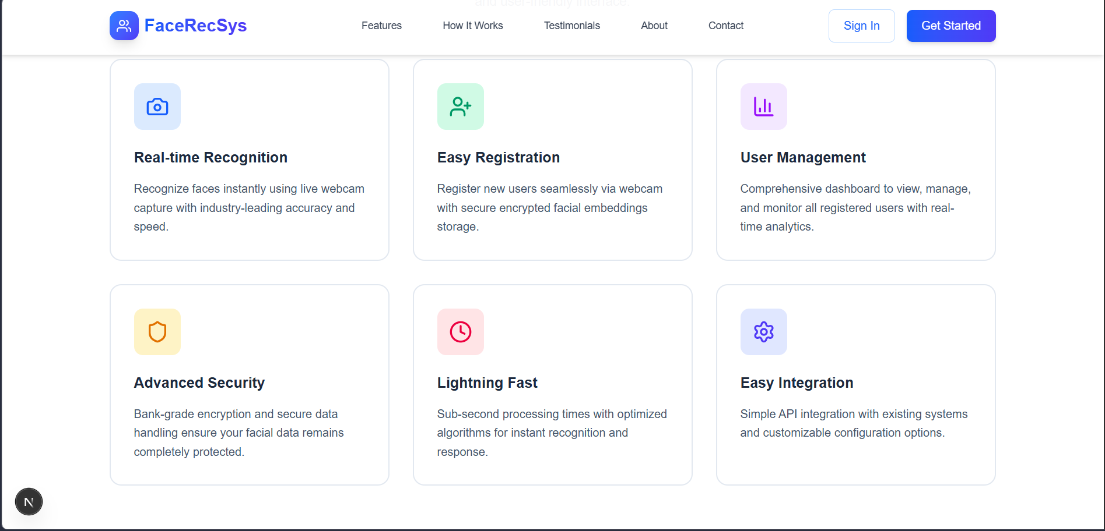
CSA1711-08

Slide 9
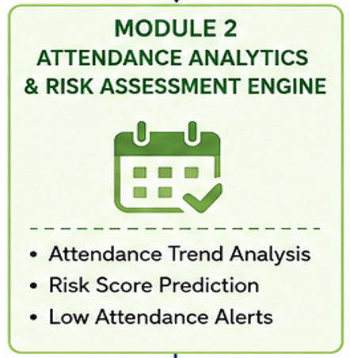
Module 2: Attendance Management & Reporting
• This module is responsible for automatically recording and managing student attendance.
• Once a student is recognized, the system automatically marks the student as Present.
• The system records important details such as Student ID, Name, Date, Time, and Attendance Status.
• Attendance information is stored in a centralized database for future use.
• The system prevents duplicate attendance from being recorded for the same student on the same day.
• Teachers or administrators can view attendance records through the system.
• The module provides student-wise, date-wise, and department-wise
attendance details.
• It can calculate the attendance percentage of each student.
• The system can generate daily, weekly, and monthly attendance reports.
• Attendance reports can be used to identify students with low attendance.
• The module reduces manual record keeping and calculation errors.
CSA1711-09

Slide 10
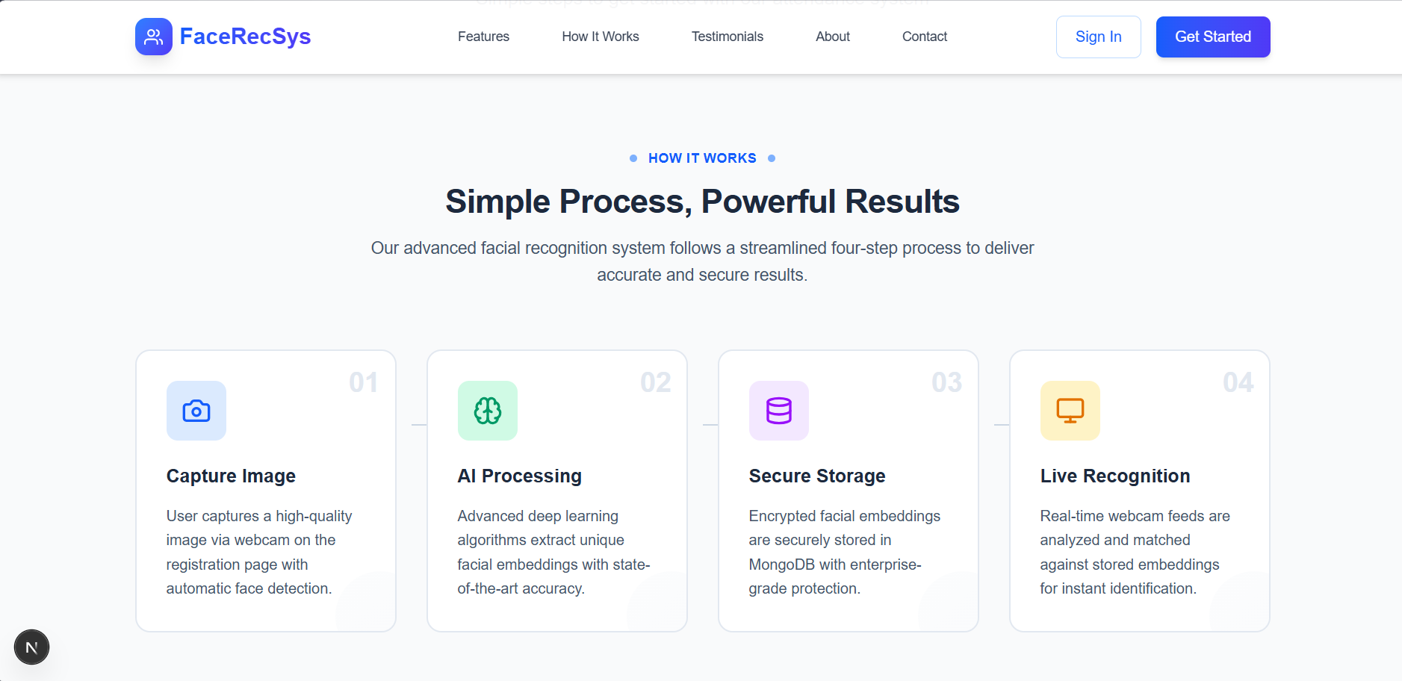
CSA1711-10

Slide 11

RESULTS AND DISCUSSION
The developed system successfully detects and recognizes registered students using a webcam.
• The system automatically marks attendance after successful face recognition.
• Student details such as ID, name, date, and time are recorded in the database.
• The system reduces the time and effort required for manual attendance.
• Duplicate attendance can be prevented by checking the existing attendance record.
• The system can identify unknown faces and avoid marking attendance for unregistered students.
• Attendance records can be viewed and analyzed through the system.
• The system provides useful attendance reports and attendance percentages.
CSA17111-11

Slide 12

CONCLUSION
• The AI-Based Face Recognition Attendance System provides an automated and efficient method for managing student attendance.
• The system successfully uses Artificial Intelligence, Computer Vision, and Face Recognition to identify students.
• It automatically records attendance, date, and time, reducing manual work.
• The system helps to reduce human errors and prevent proxy attendance.
• Attendance records are securely stored in a database and can be easily accessed.
• The system makes it easier for teachers to monitor attendance and generate reports.
• Overall, the proposed system provides a fast, accurate, reliable, and user-friendly solution for attendance management.
CSA1711-12

Slide 13

REFERENCES
• OpenCV Documentation – Computer Vision and Face Detection OpenCV Documentation
• Python Documentation – Python Programming Language Python Documentation
• Flask Documentation – Web Application Development Flask Documentation
CSA1711-13

Slide 14
THANK YOU!
ANY QUESTIONS?

